Slide 1

Statistical Computation Methods for Data Science (6HC17)
By
Dr. Santhosh Nallapu
Assistant professor of Mathematics
Department of Science and Humanities
Sreenidhi Institute of Science and Technology
Yamnampet, Ghatkesar.
1
Notes:
1

Slide 2
We discuss the following in today’s Lecture
Introduction to KNN
Comparison of Linear Regression with K-Nearest Neighbors(KNN).

Slide 3
K-Nearest Neighbor(KNN)
K-NN assumes that all instances are points in some n-dimensional space and defines neighbors in terms of distance (usually Euclidean in R-space)
K is the number of neighbors considered
The K-NN classification rule is to assign to a test sample the majority category label of its k nearest training samples.
If K=1, then the case is simply assigned to the class of its nearest neighbor

Slide 4
K-Nearest Neighbor(KNN) Simple Illustration
Choosing the value of k:
If k is too small, sensitive to noise points
If k is too large, neighborhood may include points from other classes
Choose an odd value for k, to eliminate ties
Historically, the optimal k for most data set has been between 3-10
?
k = 1:
Belongs to square class
k = 3:
Belongs to triangle class
k = 7:
Belongs to square class

Slide 5
Accuracy of all NN based classification, prediction, or recommendations depends solely on a data model, no matter what specific NN algorithm is used.
Scaling issues:
Attributes may have to be scaled to prevent distance measures from being dominated by one of the attributes.
Examples
Height of a person may vary from 4’ to 6’
Weight of a person may vary from 60kgs to 120kgs
Income of a person may vary from Rs.10k to Rs. 500k
Nearest Neighbor classifiers are lazy learners
No pre-constructed models for classification
K-Nearest Neighbor(KNN)

Slide 6
K NEAREST NEIGHBOR ADVANTAGES
Simple technique that is easily implemented
The cost of the learning process is zero
No assumptions about the characteristics of the concepts to learn have to be done
Complex concepts can be learned by local approximation using simple procedures
Extremely flexible classification scheme
does not involve preprocessing
Can sometimes be the best method

Slide 7
K NEAREST NEIGHBOR DISADVANTAGES
It is computationally expensive to find the k nearest neighbors when the dataset is very large.
Accuracy can be severely degraded by the presence of noisy or irrelevant features.
The model can not be interpreted (there is no description of the learned concepts)
Performance depends on the number of dimensions that we have equal to Attribute Selection.

Slide 8
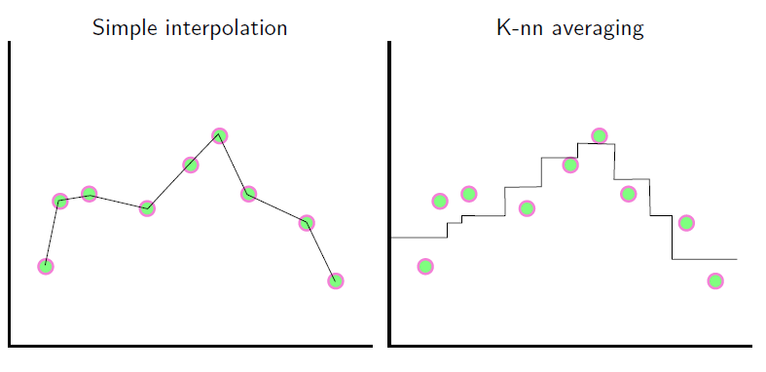
Comparison of Linear Regression with
K-Nearest Neighbors(KNN)

Slide 9
K-Nearest Neighbors(KNN) vs Linear Regression
K-Nearest Neighbors (KNN), which is a non-parametric method
K-NN linear regression fits the best line between the neighbors
Linear regression is an example of a parametric approach because it assumes
a linear functional form for f(X).
A linear regression problem has to be solved for each query (least squares regression)

Slide 10
K-Nearest Neighbors(KNN) vs Linear Regression
It do not assume an explicit form for f (X), providing a more flexible approach.
K-NN can be often more complex to understand and interpret
Easy to fit. One needs to estimate a small number of
coefficients.
Often easy to interpret

Slide 11
K-Nearest Neighbors(KNN) vs Linear Regression
If there is a small number of observations per predictor, then parametric methods then to work better.
Suppose we assume a linear relationship between X and Y but the true relationship is far from linear, then the resulting model will provide a poor fit to the data, and any conclusions drawn from it will be suspect.

Slide 12
Recapitulation:
Introduction to KNN
Comparison of Linear Regression with K-Nearest Neighbors(KNN).

Slide 13
THANK YOU
Feed Back to santhoshn@sreenidhi.edu.in
Notes:
13

